Slide 1
Building an Image Classifier

Slide 2
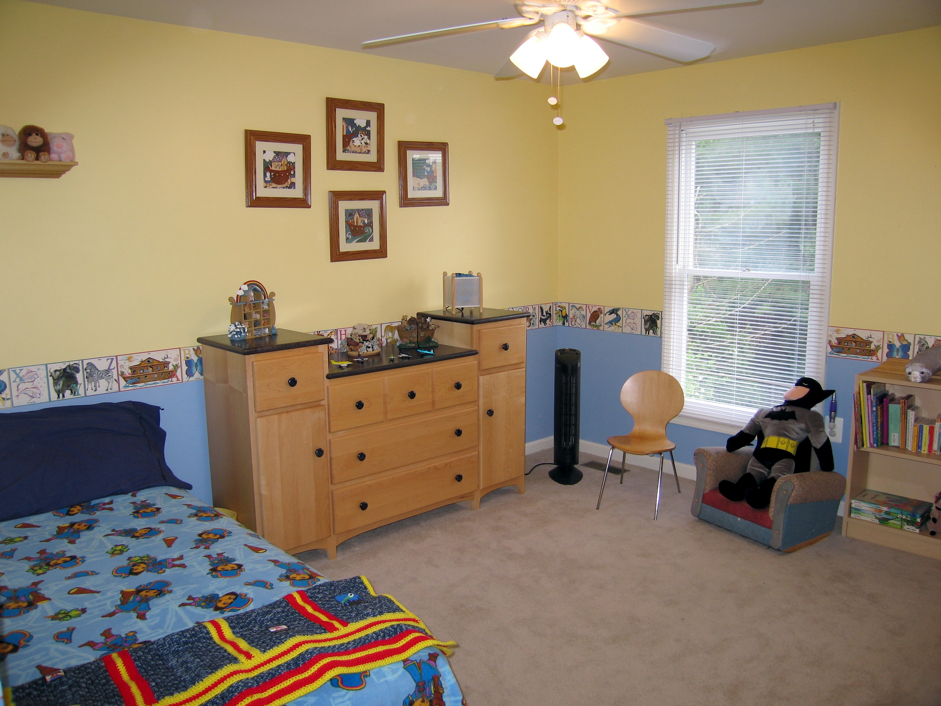
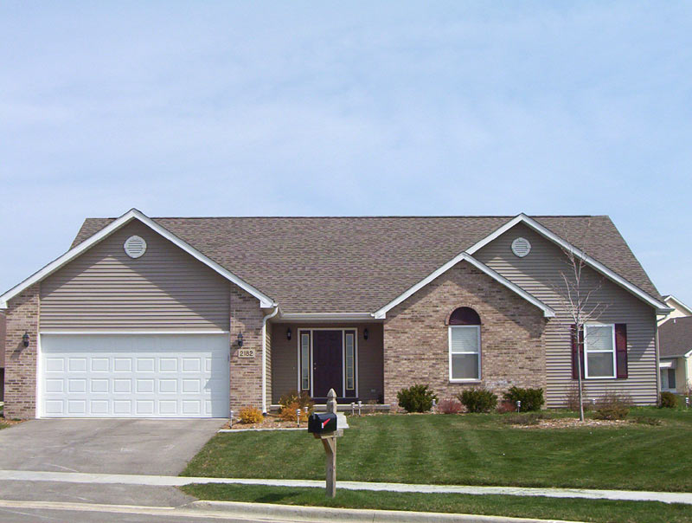
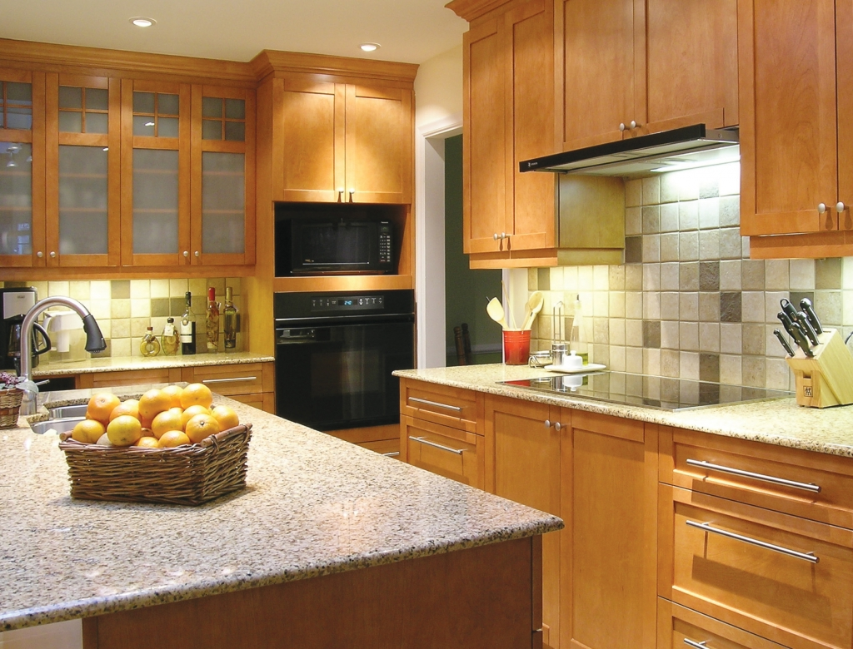

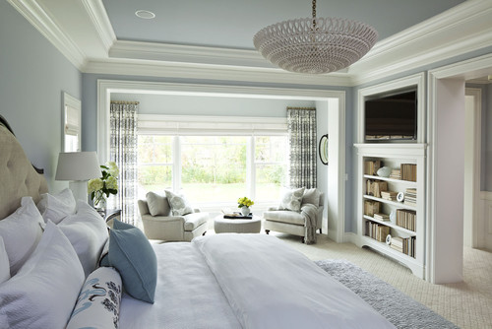
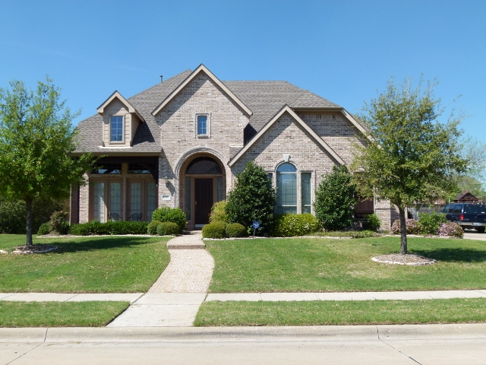
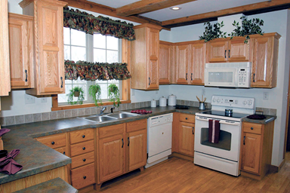
Bedroom
Kitchen

Slide 3
A Look at some of the images that we will be classifying

Slide 4
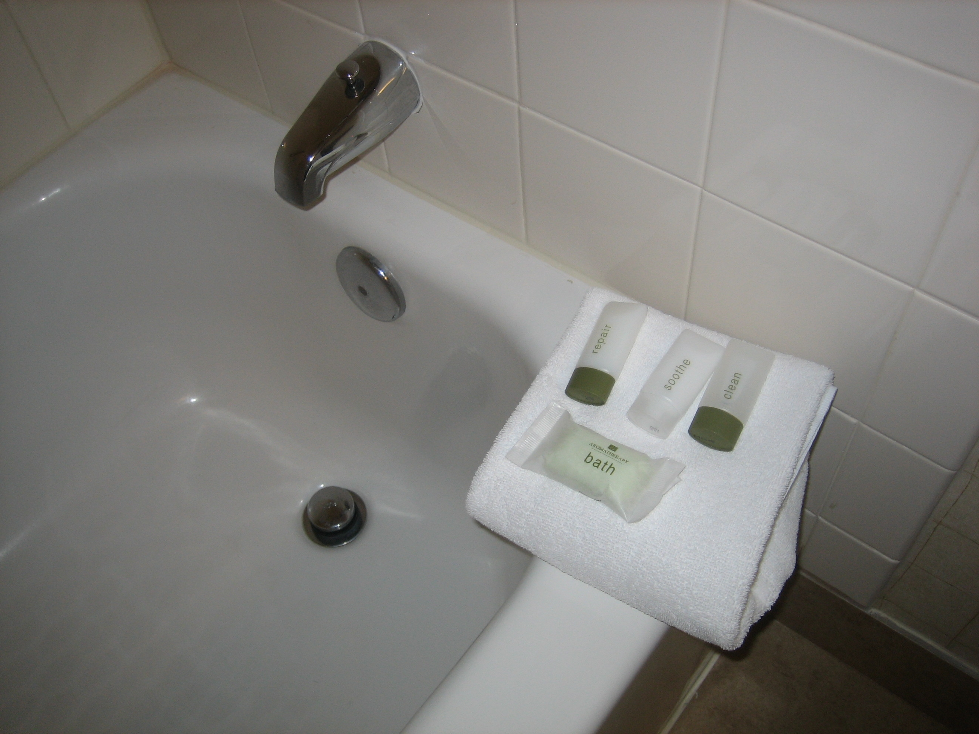
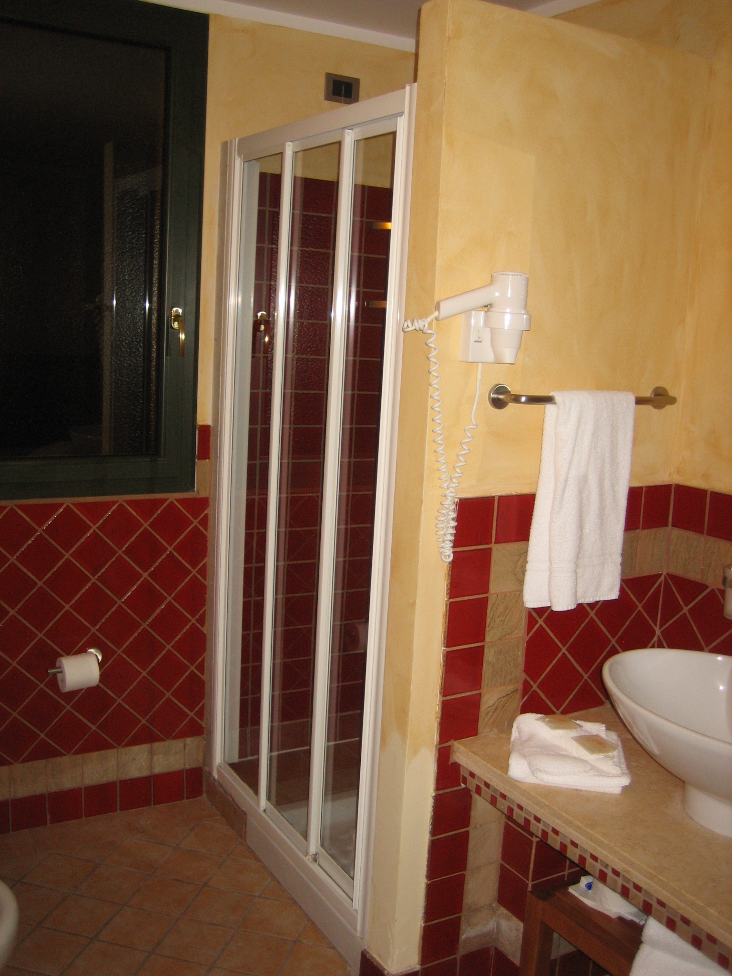
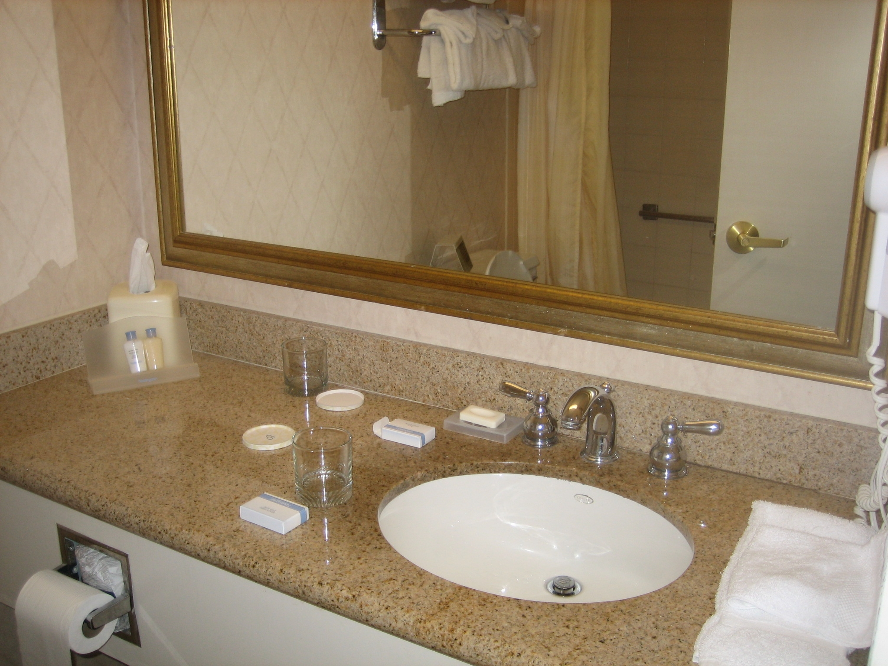
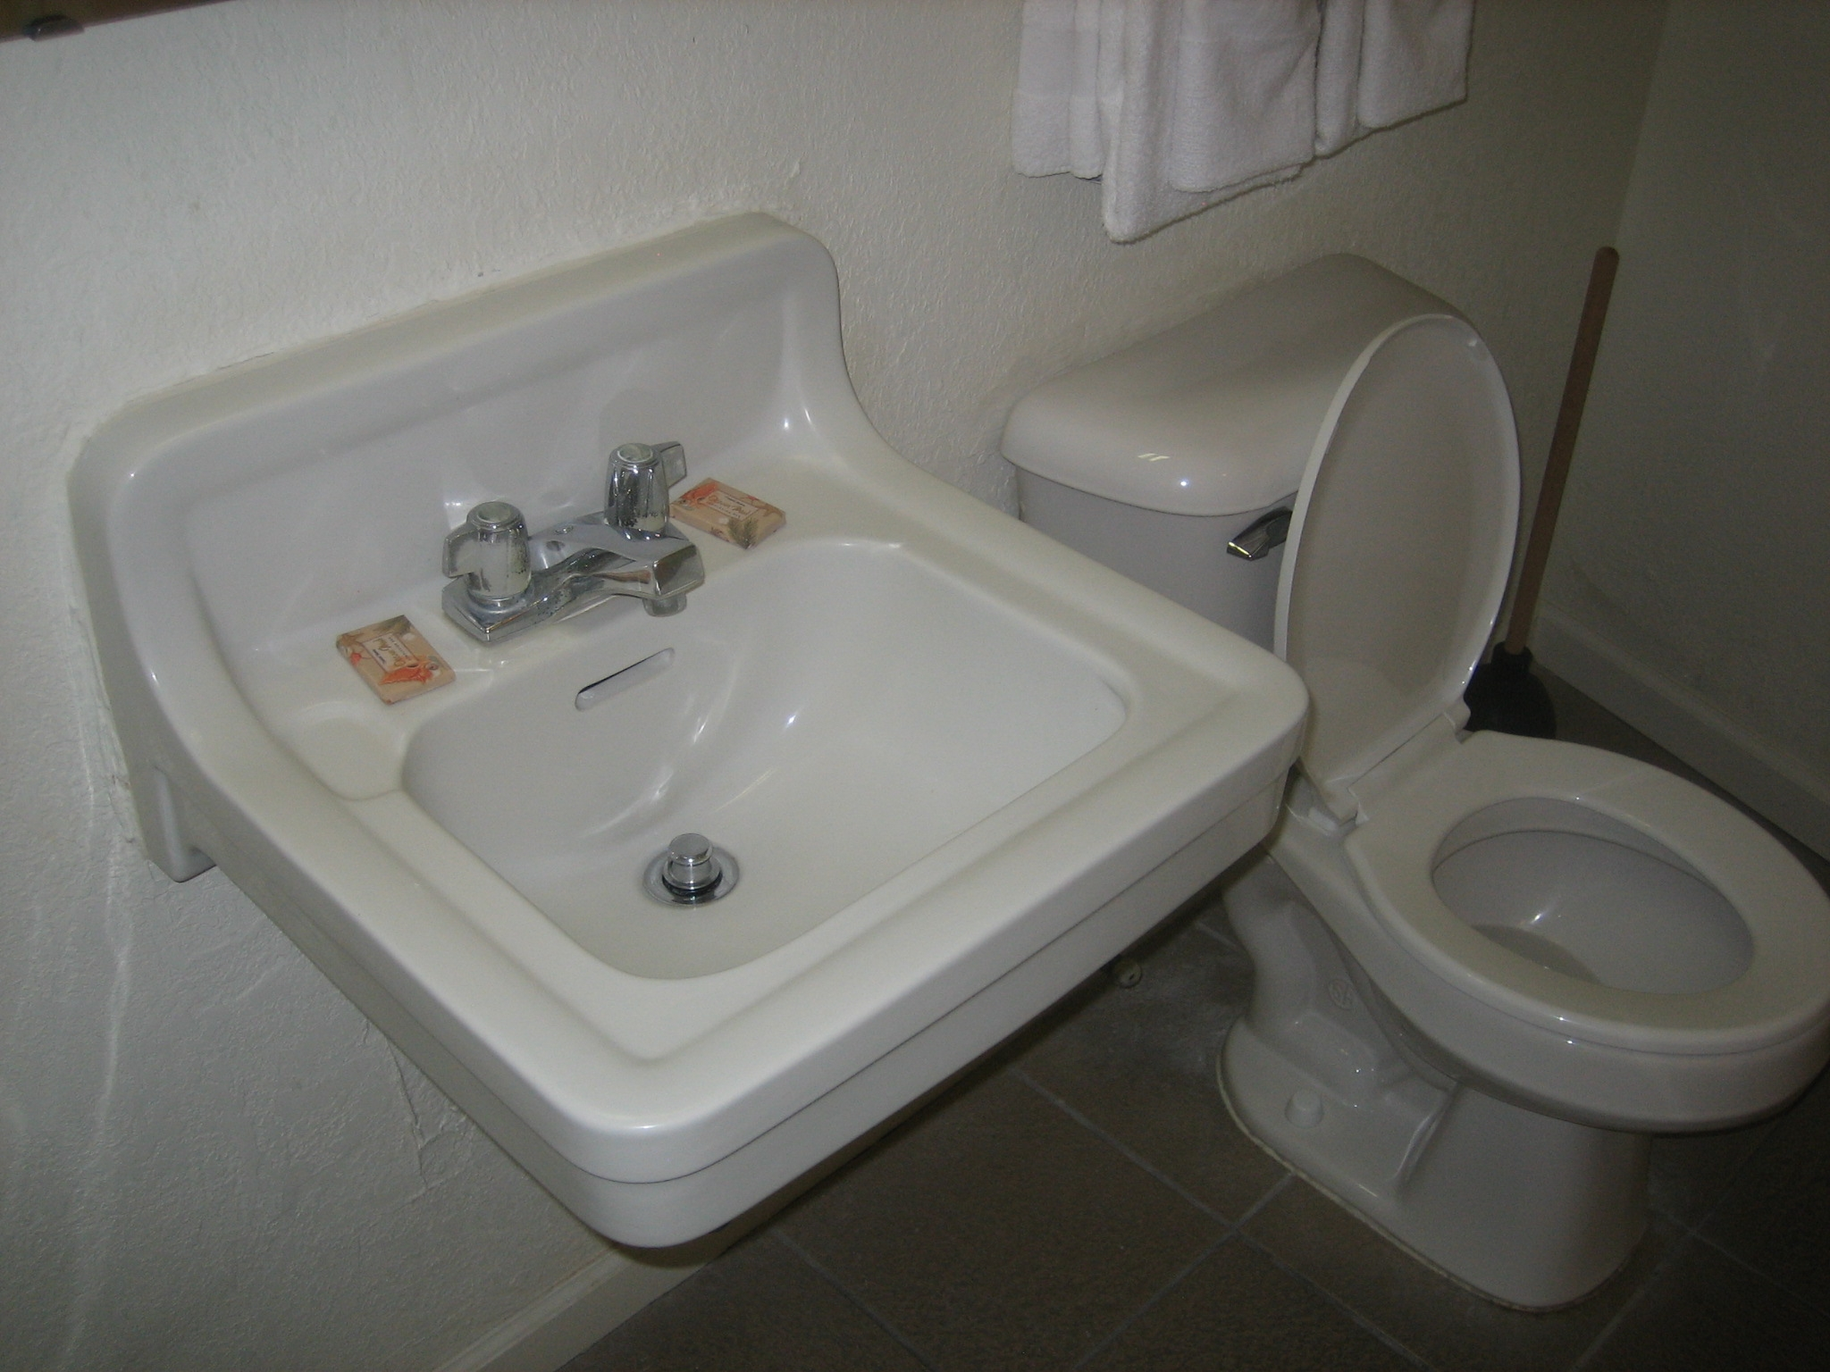
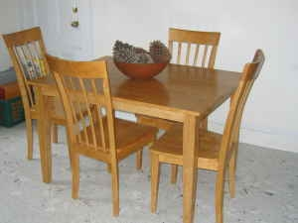
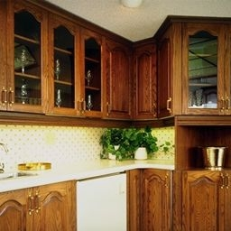
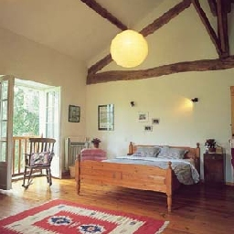
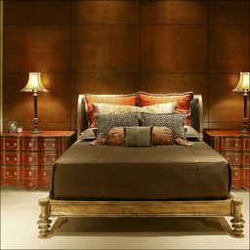
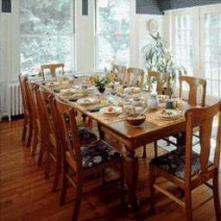
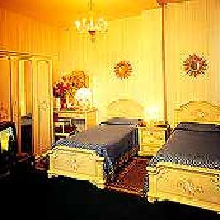
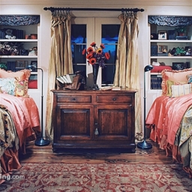
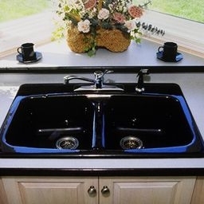
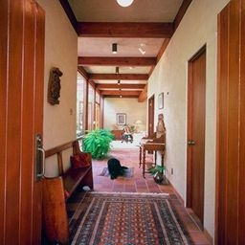

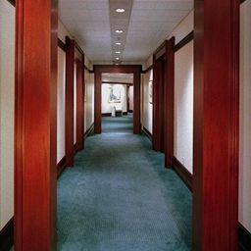
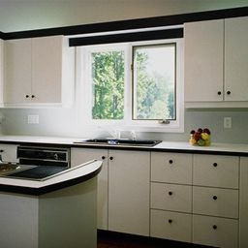
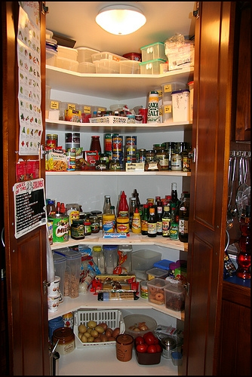
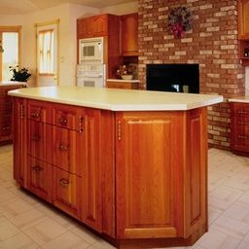
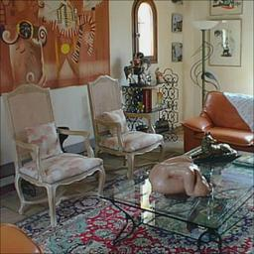
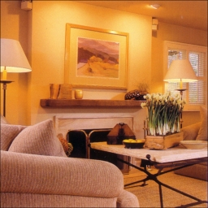
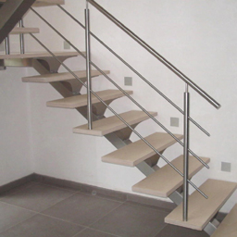
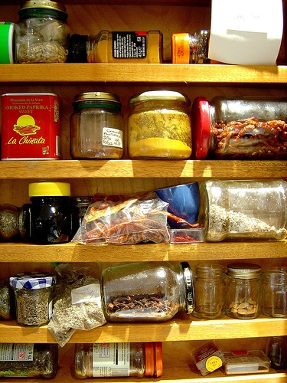

Slide 5
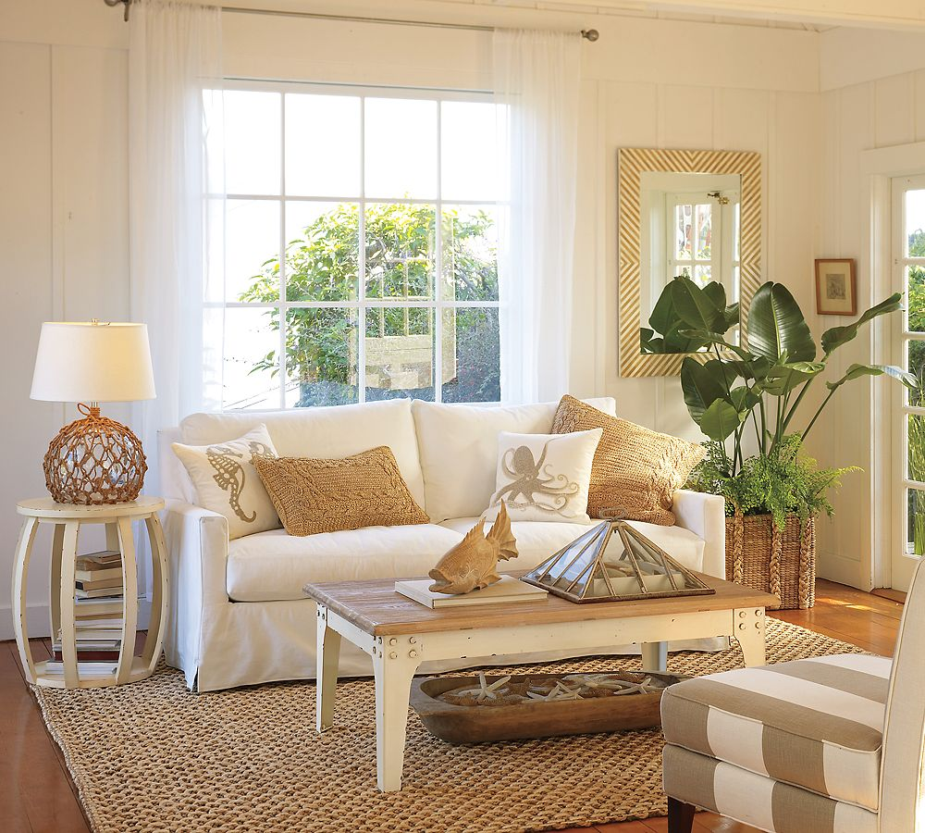
How is an Image translated into a language understood by a computer?
[[r, g, b], [r, g, b], [r, g, b],[r, g, b]],
[[r, g, b], [r, g, b],[r, g, b],[r. g, b]],
[[r, g, b], [r, g, b], [r, g, b], [r, g, b]],
[[r, g, b], [r, g, b],[r, g, b],[r, g, b]],
RGB Pixel Intensities
Range 0-255
3-D array of shape
4 X 4 X 3

Slide 6
Working with Images : Convoluted Neural Network CNN
Each image will have many pixel values == Large data
It will not be possible to use a regular Neural Network for image data as each pixel ==1 Neuron.
3. CNN helps to reduce the number of parameters in a model.
V
Image
Convolution
Pooling
Fully Connected
Layer
Soft Max

Slide 7

Convolution
Source: http://deeplearning.stanford.edu/wiki/index.php/Feature_extraction_using_convolution

Slide 8
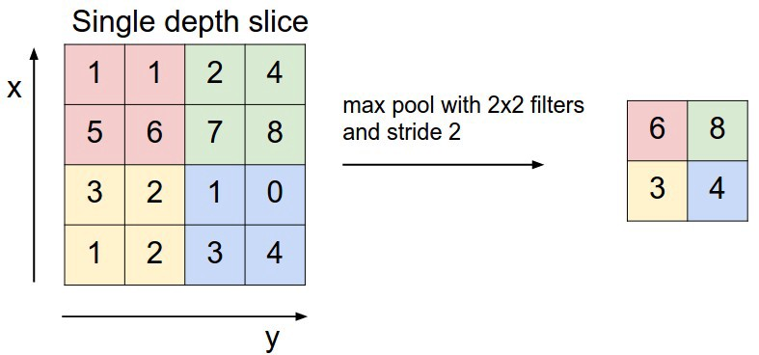
Pooling
Source: http://cs231n.github.io/convolutional-networks

Slide 9
Fully Connected Layer
Outputs an N dimensional vector where N is the number of classes that the program has to choose from

Slide 10
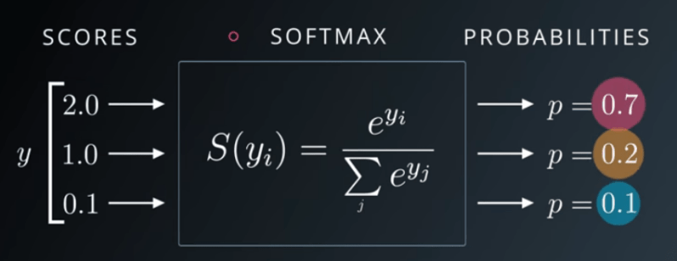
SoftMax
The softmax function calculates the probabilities of each target class over all possible target classes.
Source : https://sefiks.com/2017/11/08/softmax-as-a-neural-networks-activation-function/

Slide 11

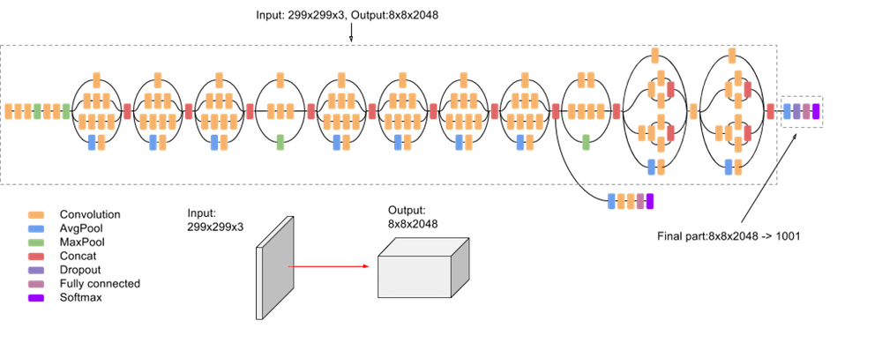
A high-level diagram of the Inception V3 model
Source: https://cloud.google.com/tpu/docs/inception-v3-advanced
This Photo by Unknown Author is licensed under CC BY-SA

Slide 12
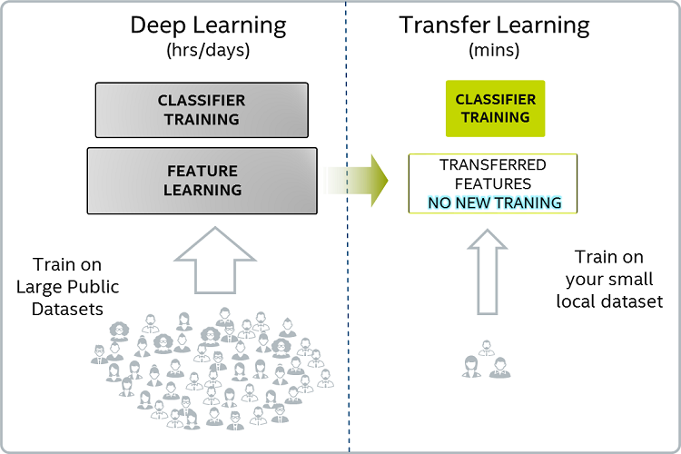
Deep Learning and Transfer Learning
Source

Slide 13
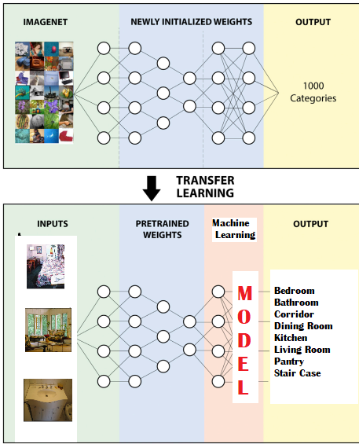
Slide adapted from:
Source

Slide 14
Train
Images
Feature Extraction
InceptionV3
Image net Weights
Test
Images
Bottleneck Layer
Logistic
Regression
Support
Vector Machine
Random Forest
XGBoost
Optimized
Logistic
Optimized
SVM
Optimized
Random Forest
Optimized
XGBoost
Model Evaluation
Accuracy
Precision
Recall
F1
Confusion

Slide 15
How did the models perform?

Slide 16
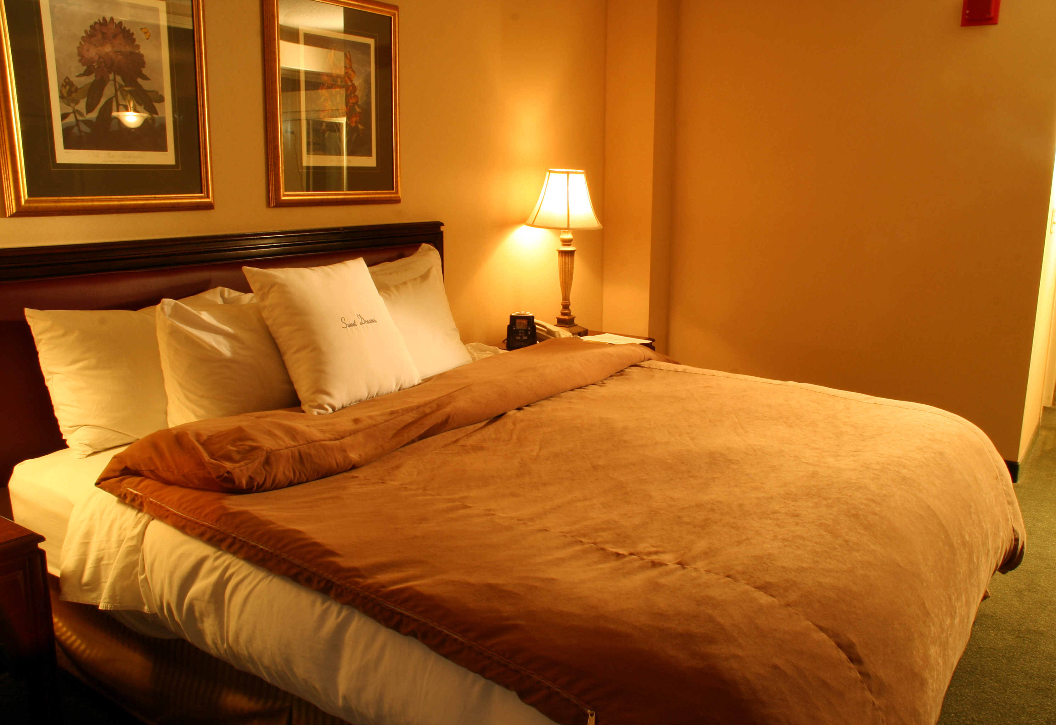

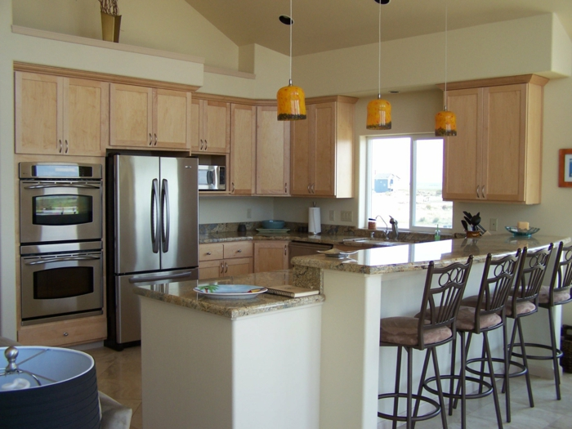
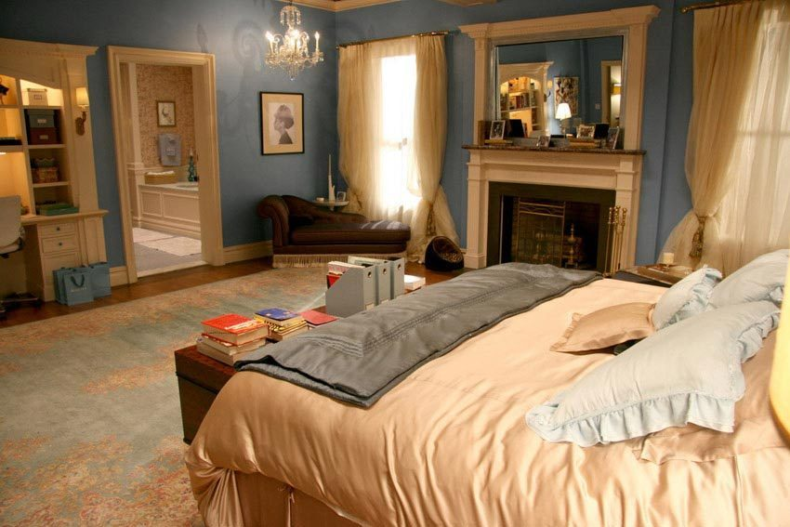

Accuracy
Bedroom
3/6
Model
Kitchen

Slide 17
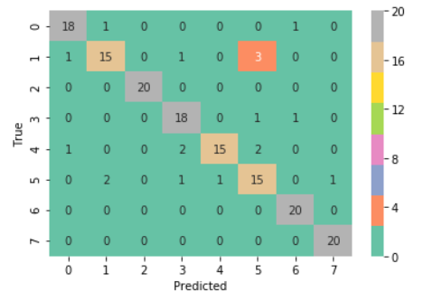
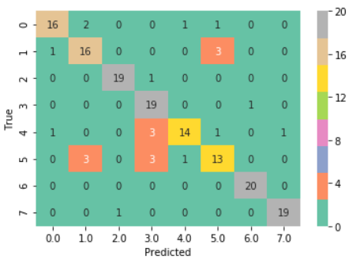
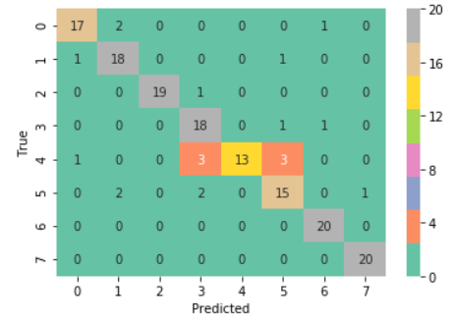
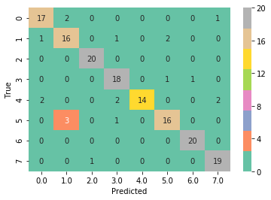
Logistic
Random Forest
0 | bathroom
1 | bedroom
2 | corridor
3 | Dining room
4 | kitchen
5 | Living room
6 | pantry
7 | staircase
Support Vector
XGBOOST

Slide 18
Accuracy
 | Logistic | Random Forest | Support Vector | XGBOOST
 | 0.881 | 0.875 | 0.875 | 0.875

Slide 19
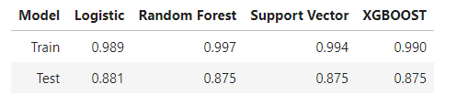
Over Fitting

Slide 20
Precision
Bedroom
2/4
Model
Kitchen
1/2

Slide 21
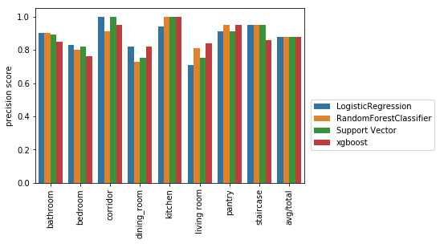
Precision

Slide 22
RECALL
Bedroom
2/3
Model
Kitchen
1/3

Slide 23
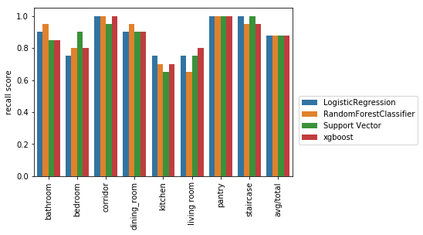
RECALL

Slide 24
F1- Score
Harmonic mean of precision and recall. F1 score will be closer to the score that is lower rather than in the center as the regular mean would be.
Precision
Recall

Slide 25
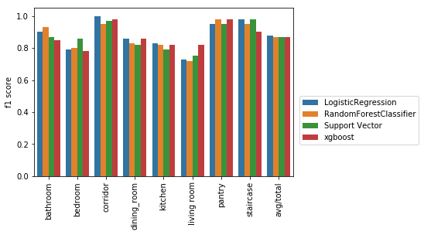
F1- Score

Slide 26
Some Incorrectly labelled Images

Slide 27
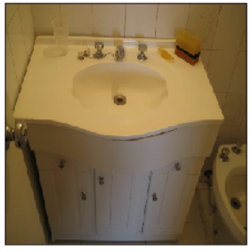
Logistic | Random Forest | Support Vector | XGBOOST
pantry | bathroom | pantry | kitchen

Slide 28
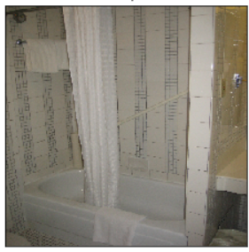
Logistic | Random Forest | Support Vector | XGBOOST
Bedroom | Bedroom | Bedroom | Bedroom

Slide 29
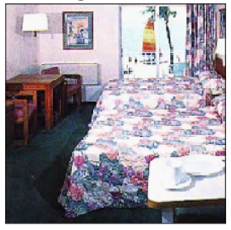
Logistic | Random Forest | Support Vector | XGBOOST
Living Room | Dining Room | Living Room | Living Room

Slide 30
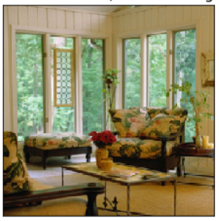
Logistic | Random Forest | Support Vector | XGBOOST
StairsCase | Corridor | Stairscase | Diningroom

Slide 31
What Next:
Extract features from a deeper layer of the neural network
Evaluate other neural networks for feature extraction
More insight into the classification process : LIME
Increase number of images.

